Slide 1


Intelligent Academic Planner
Daria Cook, Krystal Elliott, Xiaoyu Zhou
April 29, 2017

Slide 2



Introduction
What are we doing?
Using IBM Watson and BlueMix APIs to conduct textual analysis on questions asked and personal information provided by end users, such as student and even advisor.
What is the need for this project?
Students are often unsure of which fields would coincide with their interests and talents.
What is our objective with this project?
Enable students to make better career decisions.
Notes:
What is the need for this project => reduce the effect of physical barrier between helpful information and the person who need it.
What is the objective for this project => Provide smart solutions by AI Technology...by QA and Assessment System.

Slide 3
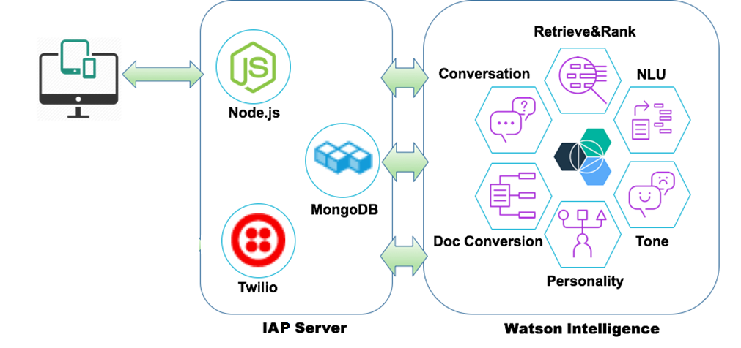
Project Architecture

Slide 4
Project Demo

Slide 5
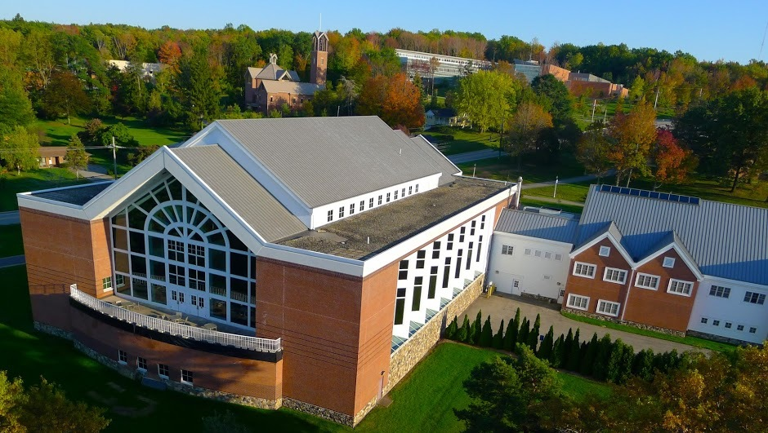
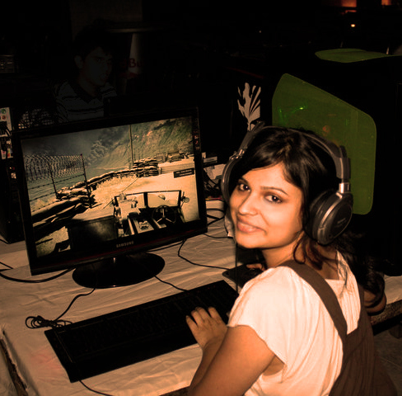
A high school student is considering her future. She is trying to decide which colleges to apply to. She is considering a few factors.
She loves video games.
She wants to be involved in clubs on campus.
She is from Philadelphia, but she wants to live somewhere “green”.

Slide 6
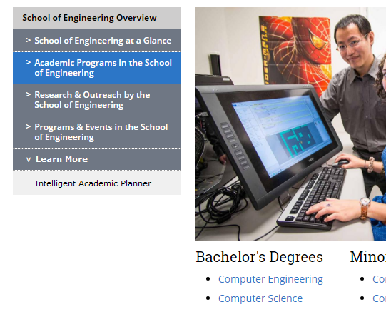
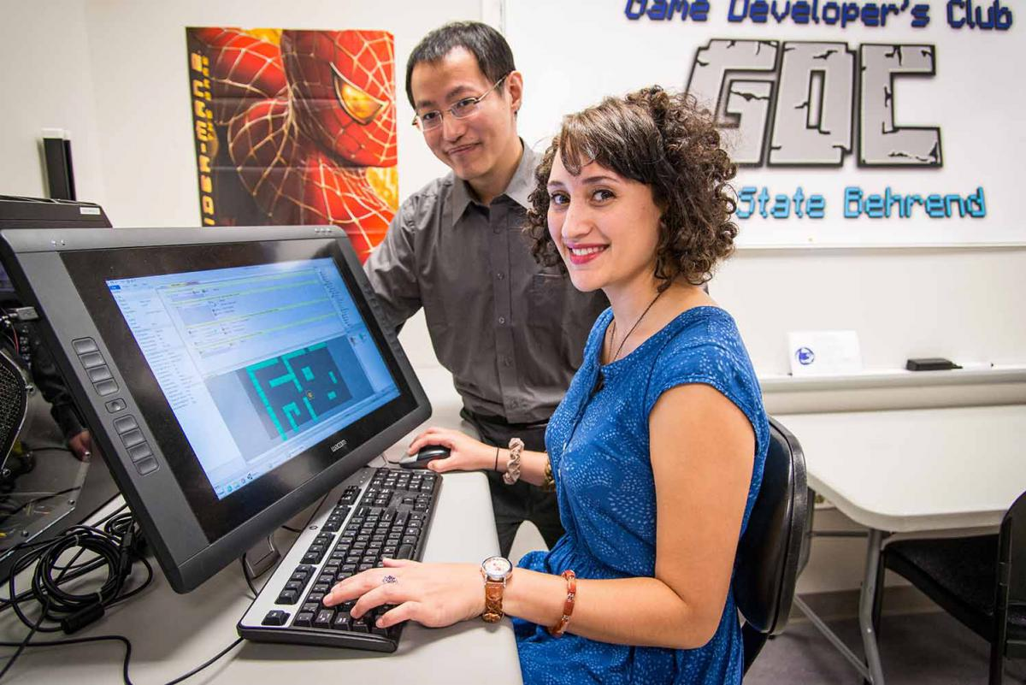

Slide 7
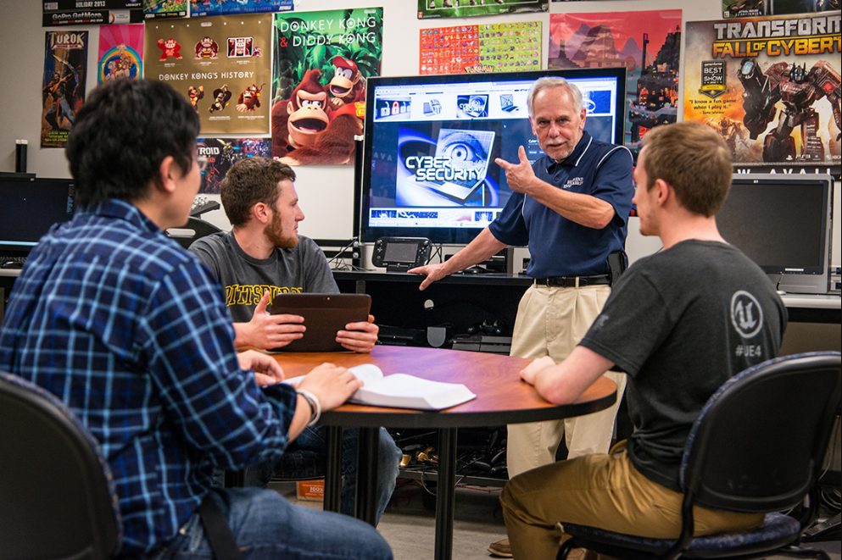
Questions
Are the engineering programs at Behrend accredited?
What is Behrend's tuition?
What scholarships are offered at Behrend?
What is the salary of a Computer Scientist?
What is Erie like?
Tell me more about Behrend.
What is CSSE?
What is Computer Science?
What if I’m not good at math?
Does Behrend have tutors?
Do Computer Scientists make video games?
Is there a club for game developers?
Are there other clubs at Behrend?
What is the crime rate at Behrend?
Notes:
‹#›

Slide 8
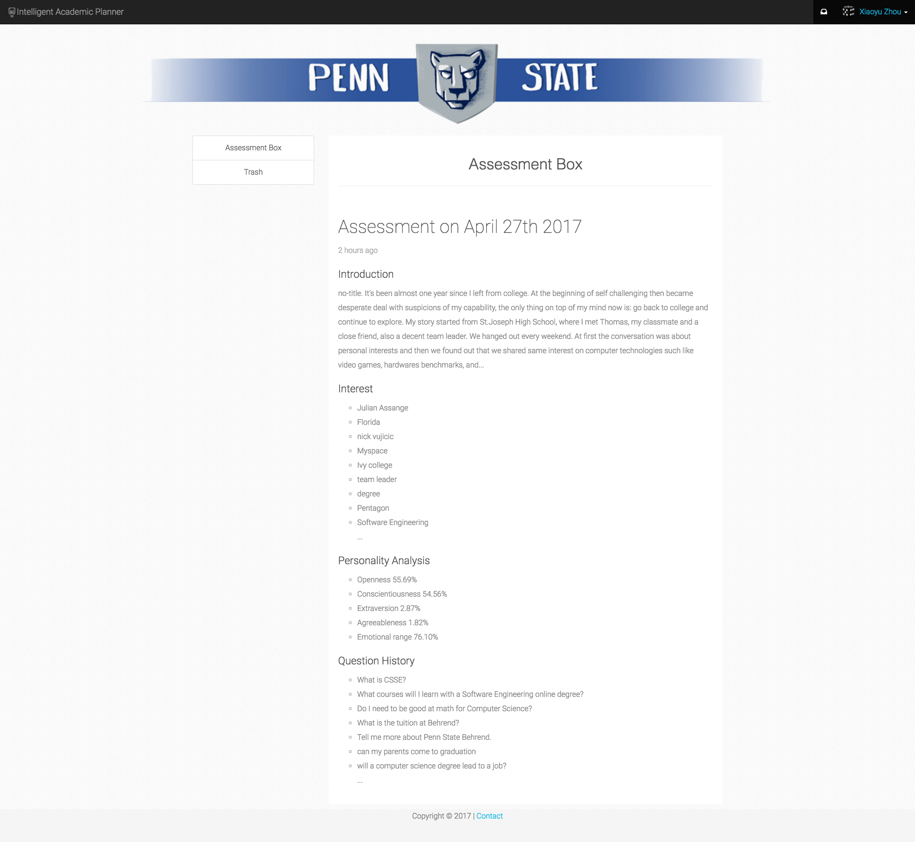
Assessment Inbox

Slide 9
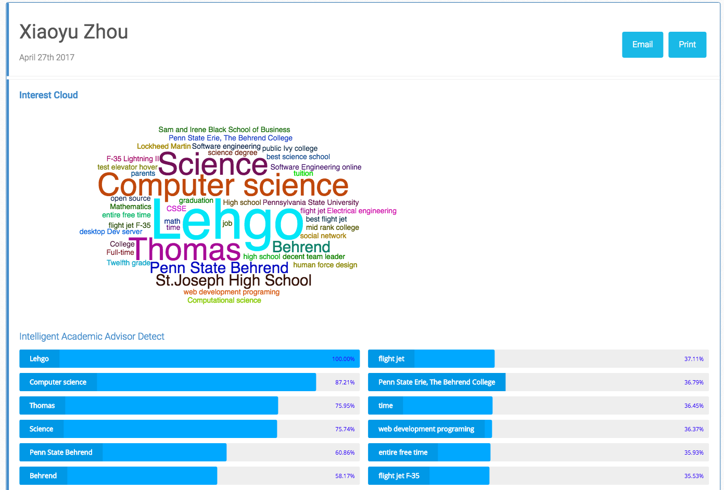
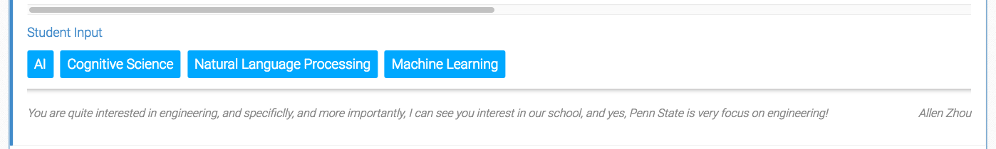
Assessment - Interest

Slide 10
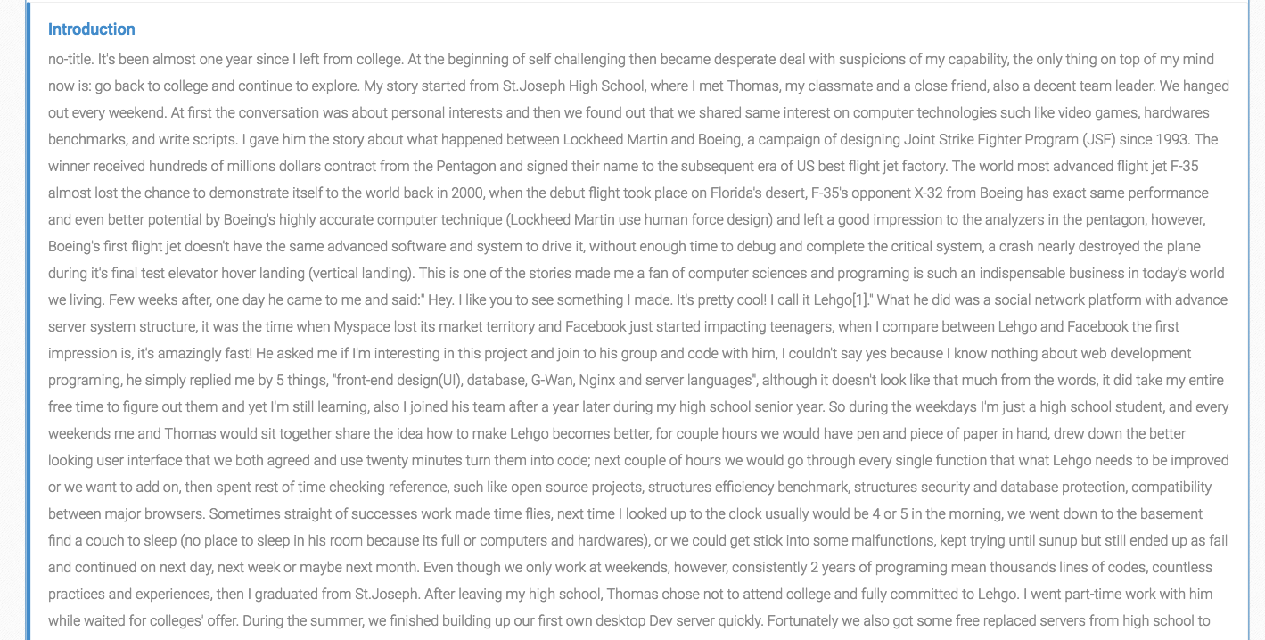
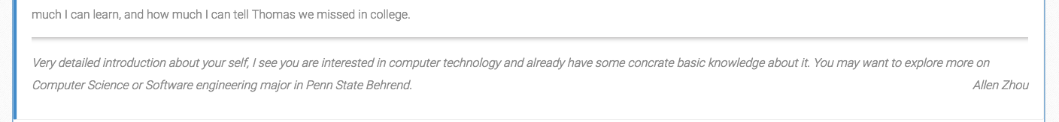
Assessment - Introduction

Slide 11
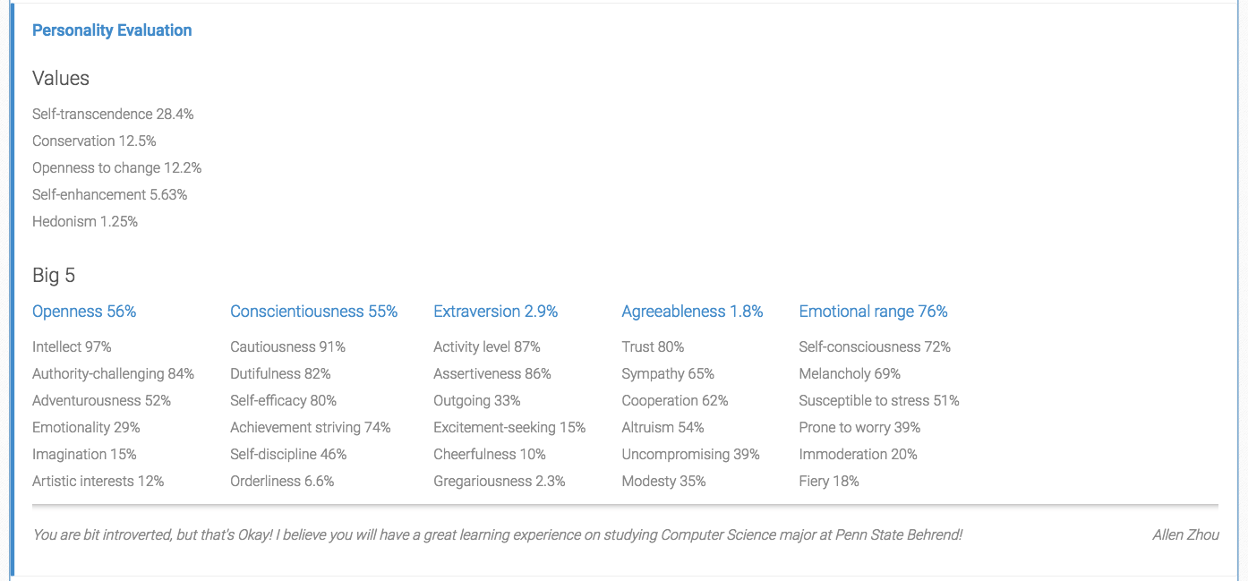
Assessment - Personality

Slide 12
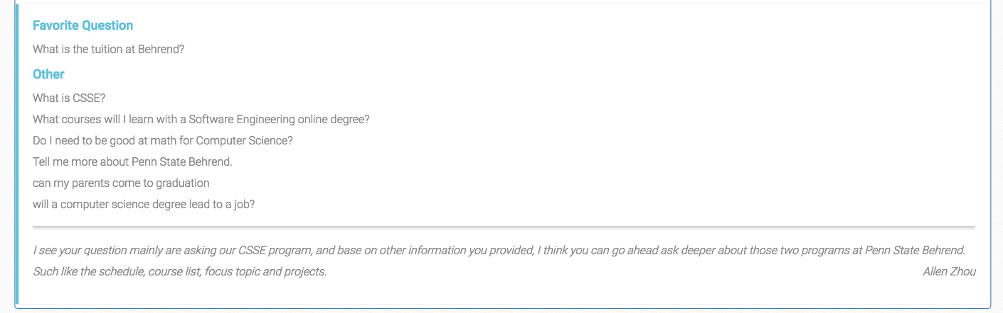
Assessment - Question History

Slide 13
Lessons Learned

Slide 14






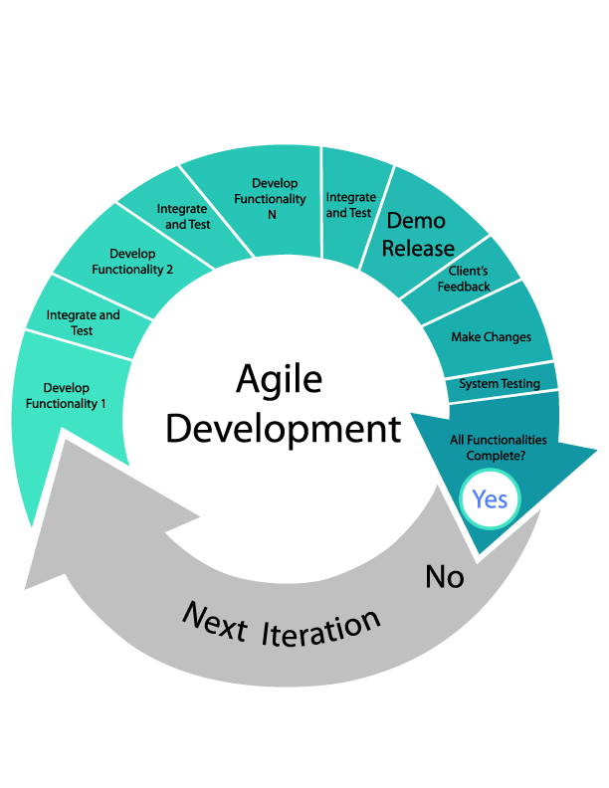



Programing
Theory
Team Work

Slide 15


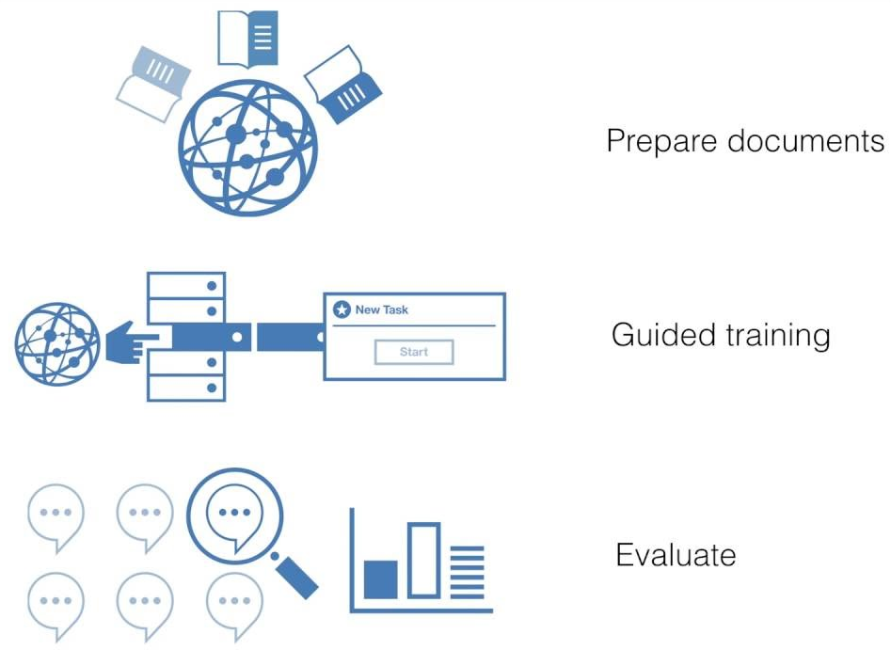



Slide 16



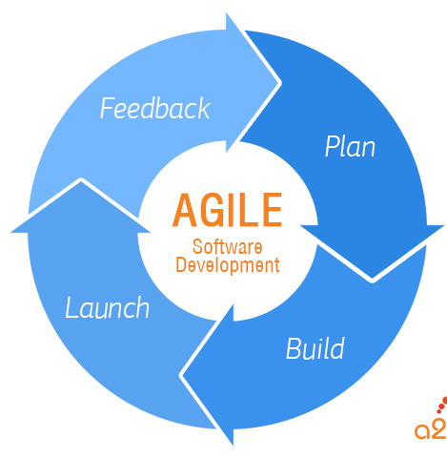



Notes:
Front end: responsive designs, javascript/jquery, design/styling, frameworks. Agile development and integration. Communication and teamwork. Git.

Slide 17

QUESTIONS?

